Slide 1
Attrition Analysis at DDS Analytics
Lijju Mathew
August 15th, 2020

Slide 2
Outline
Objectives.
Data.
EDA.
Attrition Analysis.
Job role specific trends.
Model selection for attrition prediction.
Model selection for salary prediction.
Top 3 factors leading to turnover
Conclusion
Artifacts

Slide 3
Objectives
Identify top 3 factors leading to attrition.
Identify any job role specific trends.
To build a model to predict attrition with at least 60/60 sensitivity/specificity.
To build a model to predict salary with lowest RMSE

Slide 4
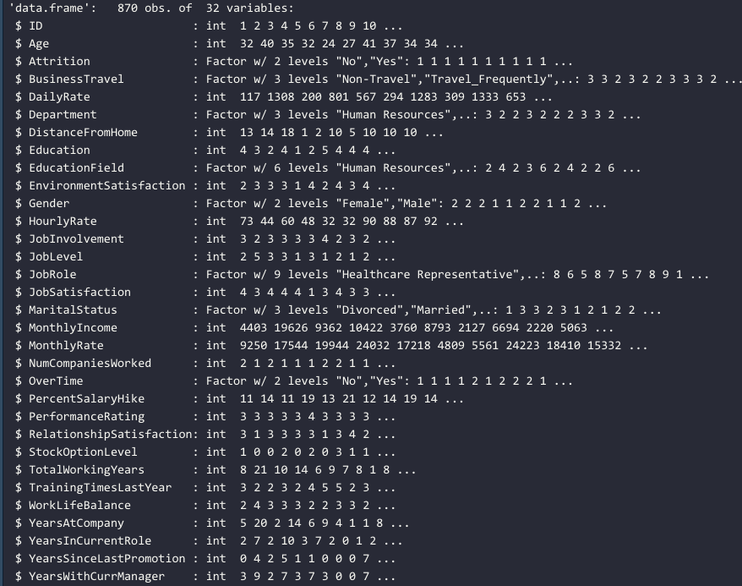
Data
3 Datasets
CaseStudy2-data.csv
CaseStudy2CompSet No Attrition.csv
CaseStudy2CompSet No Salary.csv
No missing values in data set.
Attrition Values Yes(19%) and No (81%)
Had to down sample the data to get a balanced data for training models.

Slide 5
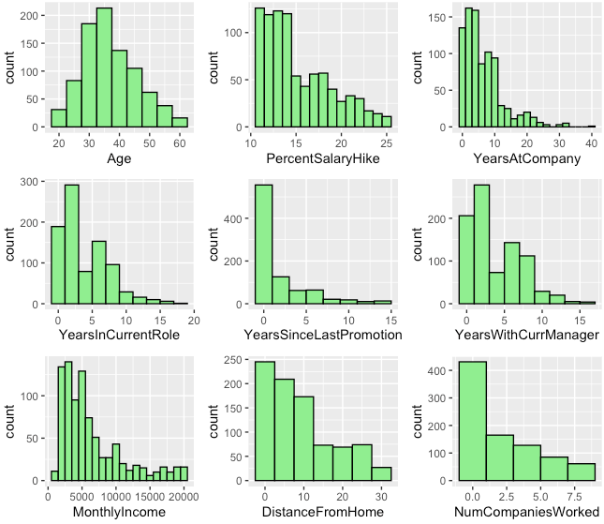
EDA
Normally Distributed
Age
Right Skewed
Percentage Salary Hike
Years at Company
Years in Current Role
Years since last promotion
Years with current manager
Monthly Income
Distance from home
Number of companies worked

Slide 6
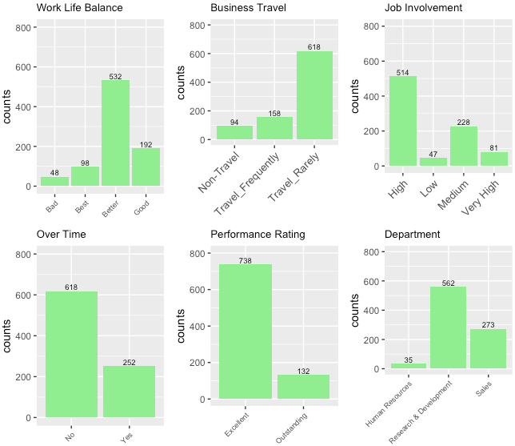
EDA
60% of employees feel they have better work life balance.
70% of employees travel rarely to work.
59% of the employees are highly involved in the job.
70% of employees are working over-time.
85% of employees have excellent performance rating

Slide 7
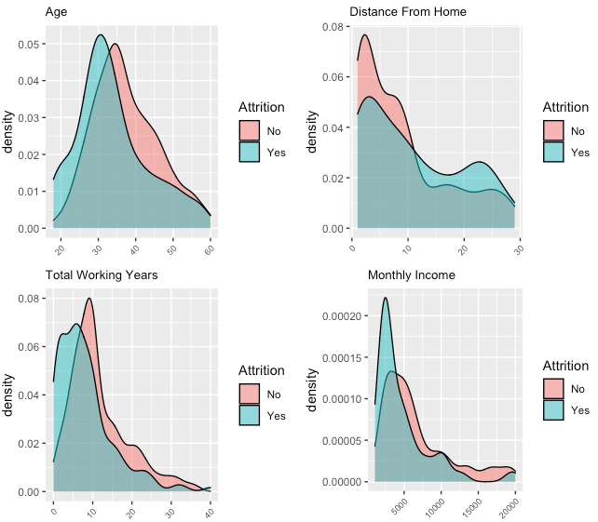
Attrition Analysis
Younger employees within 25-35 years have higher attrition rate.
Lower attrition rate when the distance from home is with 10 units.
Attrition rate tends to be higher when employees have worked with 5 to 7 companies previously.
Observe a peak in attrition at a monthly income of 2500 approx.

Slide 8
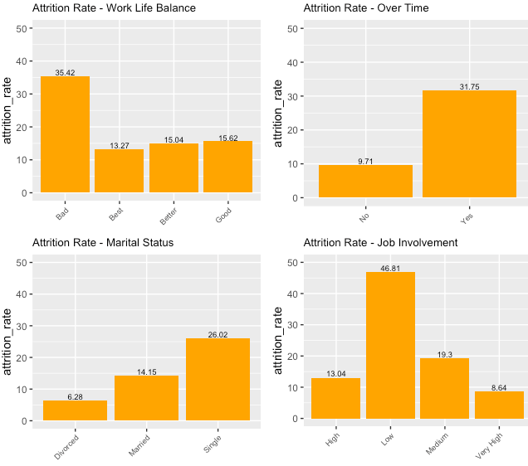
Attrition Analysis
As expected, attrition rate is high when work life balance is bad.
Attrition rate is almost 30% among employees who work overtime.
Attrition is high among singles.
It is also highest who have low job involvement.

Slide 9
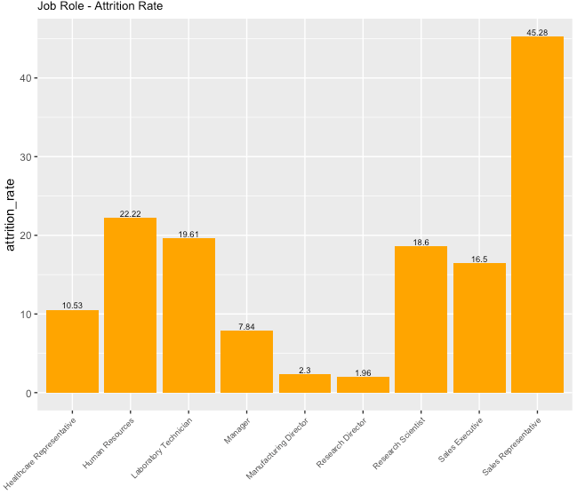
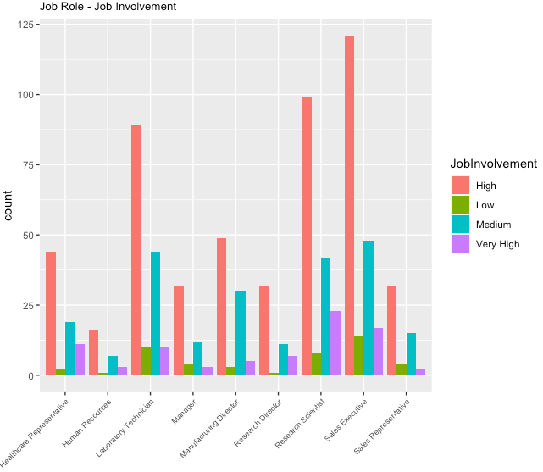
Job Role Specific Trends
Attrition is high in Sales representative role.
Sales executives followed by Research scientist and Lab tech have high Job involvement.

Slide 10
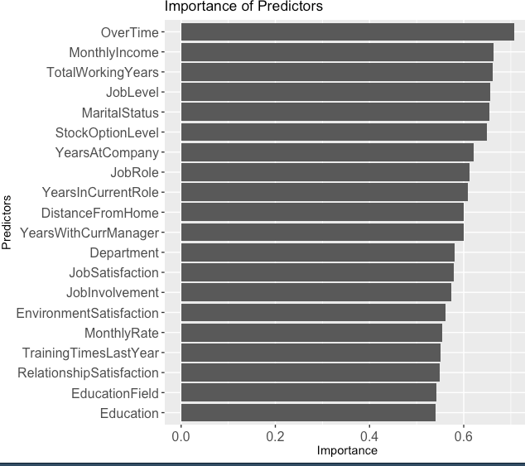
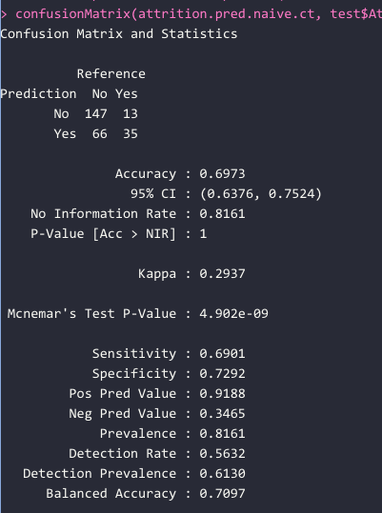
Model Selection for Attrition Prediction
Model Selection
First built a full model using Naive Bayes.
Trained the model and got the importance of predictors.
Then reduced the model, picking the important predictors and removing redundant predictors that have correlation.
Iteratively built 5 models.
Same approach followed using KNN.
Best Model
Naïve Bayes Model
Attrition ~ OverTime + MonthlyIncome + MaritalStatus + StockOptionLevel + JobSatisfaction + DistanceFromHome + YearsWithCurrManager
Accuracy : 69.73%
Sensitivity : 69.01%
Specificity : 72.92 %

Slide 11
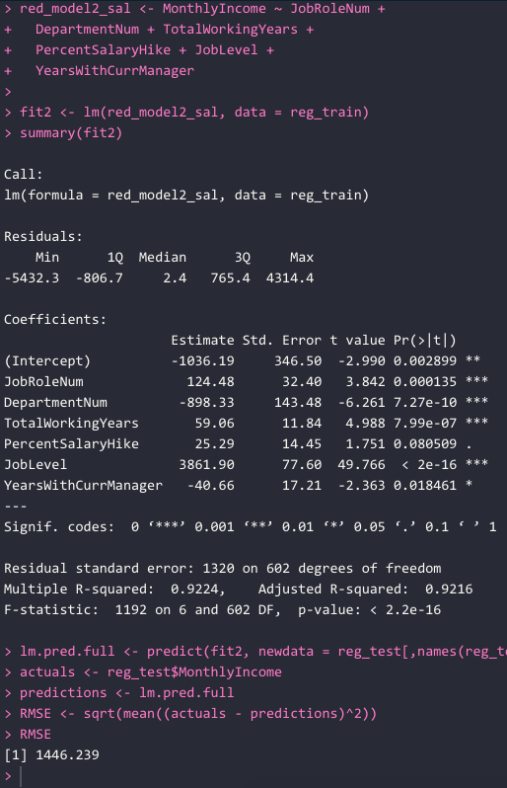
Model Selection for Salary Prediction
Model Selection
First built a full model using Linear Regression model.
Then reduced the model, picking the important predictors based on statistical significance from full model and removing redundant predictors that have correlation.
Iteratively built 5 models.
Built couple of models using Logistic Regression
Best Model
Linear Regression Model
MonthlyIncome ~ JobRoleNum + DepartmentNum + TotalWorkingYears + PercentSalaryHike + JobLevel + YearsWithCurrManager
RMSE : 1453.472

Slide 12
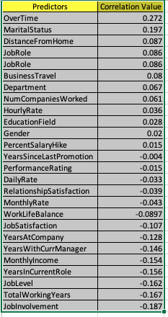
Top 3 Factors leading to turnover
Top 3 factors leading to Attrition
Based on importance of predictors from Naïve Bayes, KNN, Linear Regression Model and Correlation values, below are the top 3 factors leading to attrition
Over Time
Marital Status
Distance From Home

Slide 13
Conclusion
Summary
Job Role Specific Trends
Attrition is high in Sales representative role.
Sales executives followed by Research scientist and Lab tech have high Job involvement
Best Model for Attribute Prediction
Naïve Bayes Model with Sensitivity : 69.01% and Specificity : 72.92 %
Best Model for Salary Prediction
Linear Regression Model with RMSE : 1453.472
Top 3 factors leading to Attrition
Over Time
Marital Status
Distance From Home

Slide 14
Artifacts
Github Link - https://github.com/lijjumathew/MSDS-Doing-Datascience-Project2.git

